Slide 1
2월13일 1교시 과제

Slide 2
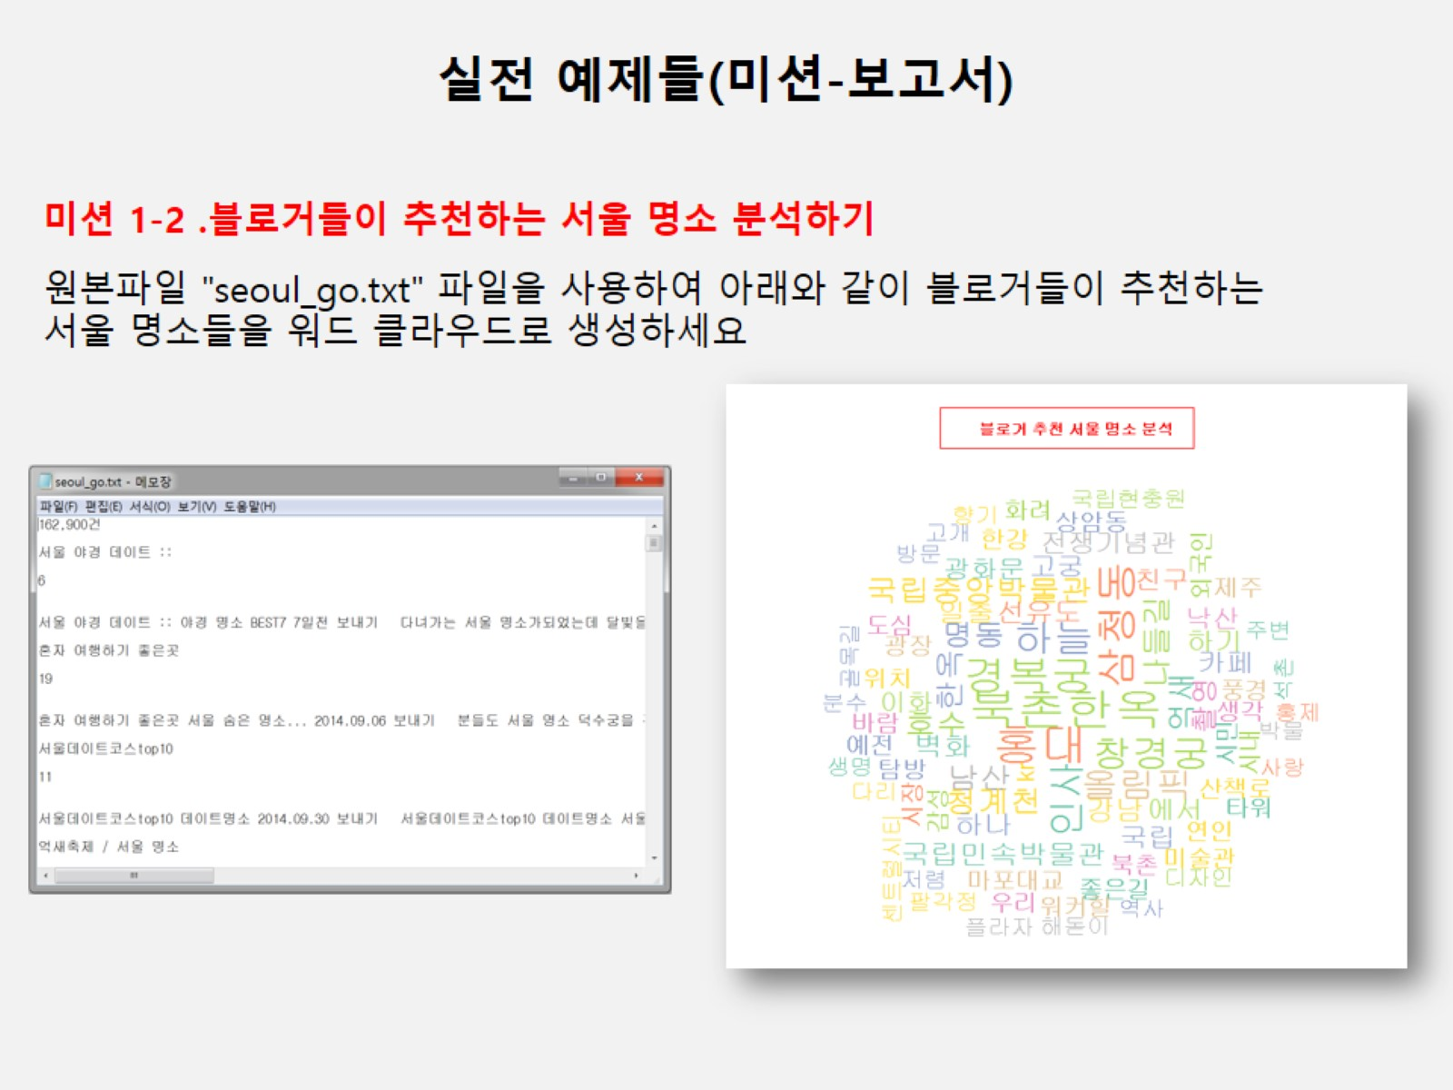

Slide 3
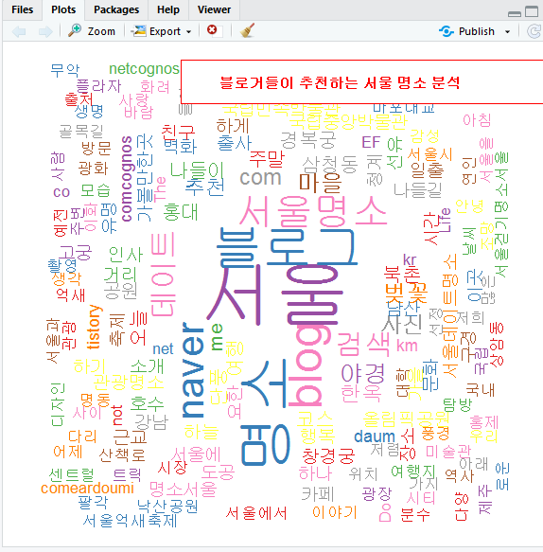
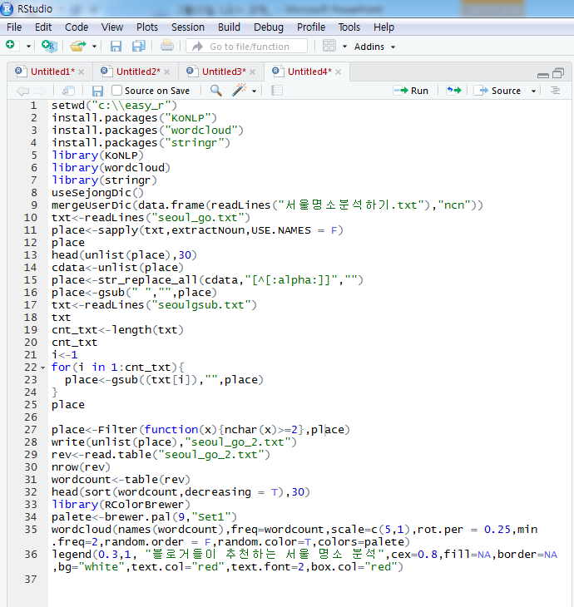
Seoul_go 파일 이용
Notes:
setwd("c:\\easy_r")
install.packages("KoNLP")
install.packages("wordcloud")
install.packages("stringr")
library(KoNLP)
library(wordcloud)
library(stringr)
useSejongDic()
mergeUserDic(data.frame(readLines("서울명소분석하기.txt"),"ncn"))
txt<-readLines("seoul_go.txt")
place<-sapply(txt,extractNoun,USE.NAMES = F)
place
head(unlist(place),30)
cdata<-unlist(place)
place<-str_replace_all(cdata,"[^[:alpha:]]","")
place<-gsub(" ","",place)
txt<-readLines("seoulgsub.txt")
txt
cnt_txt<-length(txt)
cnt_txt
i<-1
for(i in 1:cnt_txt){
place<-gsub((txt[i]),"",place)
}
place
place<-Filter(function(x){nchar(x)>=2},place)
write(unlist(place),"seoul_go_2.txt")
rev<-read.table("seoul_go_2.txt")
nrow(rev)
wordcount<-table(rev)
head(sort(wordcount,decreasing = T),30)
library(RColorBrewer)
palete<-brewer.pal(9,"Set1")
wordcloud(names(wordcount),freq=wordcount,scale=c(5,1),rot.per = 0.25,min.freq=2,random.order = F,random.color=T,colors=palete)
legend(0.3,1, "블로거들이 추천하는 서울 명소 분석",cex=0.8,fill=NA,border=NA,bg="white",text.col="red",text.font=2,box.col="red")

Slide 4
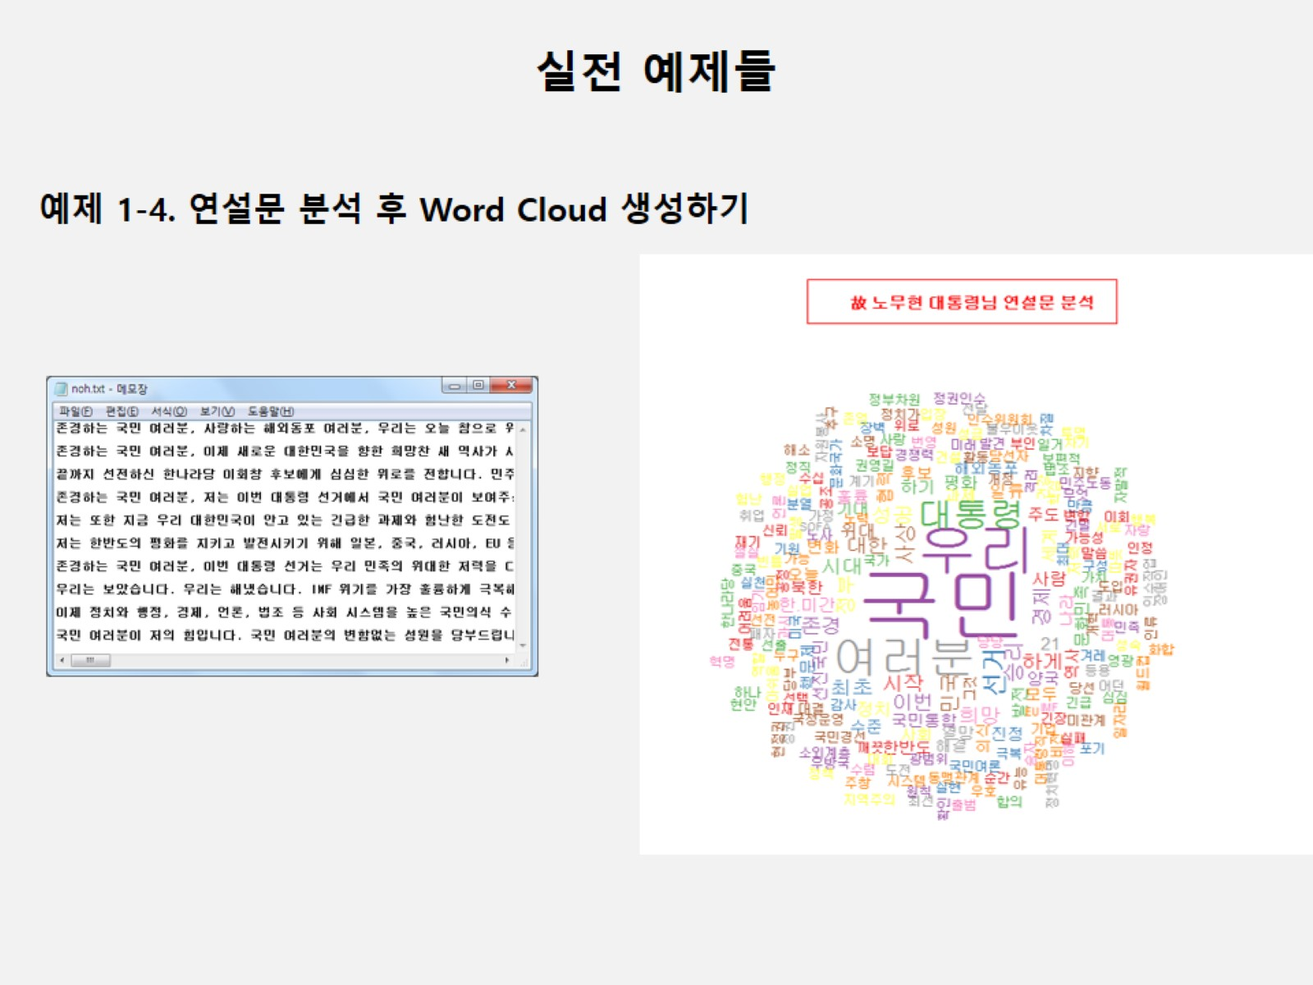

Slide 5
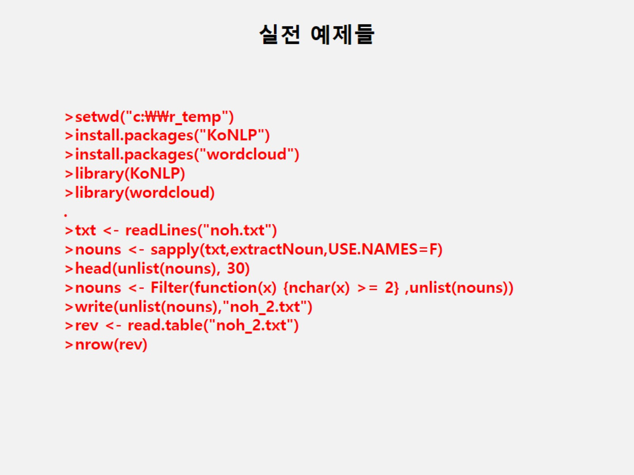
Notes:
ㅇ

Slide 6
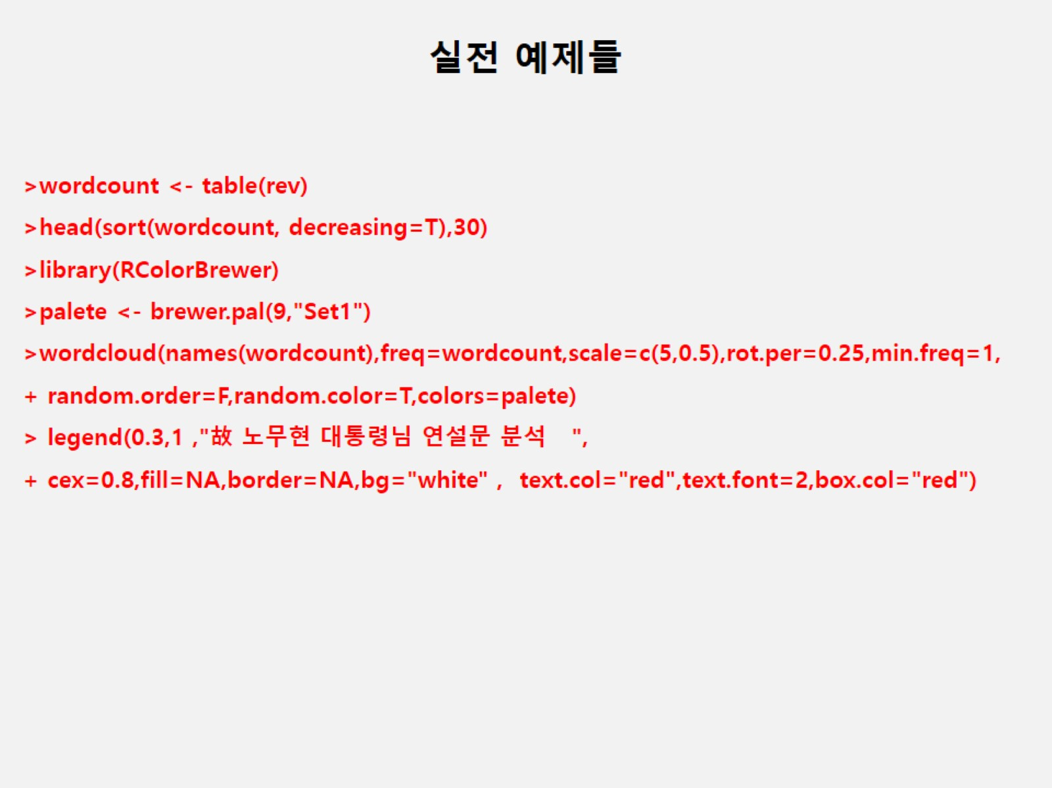

Slide 7
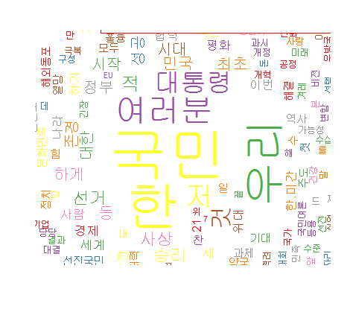
노무현 대통령님 연설 분석
Notes:
setwd("c:\\easy_r")
install.packages("KoNLP")
install.packages("wordcloud")
library(KoNLP)
library(wordcloud)
txt<-readLines("noh.txt")
nouns<-sapply(txt,extractNoun,USE.NAMES = F)
head(unlist(nouns),30)
nouns<-Filter(function(x){nchar(x)>=2},nouns)
write(unlist(nouns),"noh_2.txt")
rev<-read.table("noh_2.txt")
nrow(rev)
wordcount<-table(rev)
head(sort(wordcount,decreasing = T),30)
library(RColorBrewer)
palete<-brewer.pal(9,"Set1")
wordcloud(names(wordcount),freq=wordcount,scale=c(5,0.5),rot.per = 0.25,min.freq=1,random.order = F,random.color=T,colors=palete)
legend(0.3,1, "故노무현 대통령님 연설문 분석",cex=0.8,fill=NA,border=NA,bg="white",text.col="red",text.font=2,box.col="red")

Slide 8
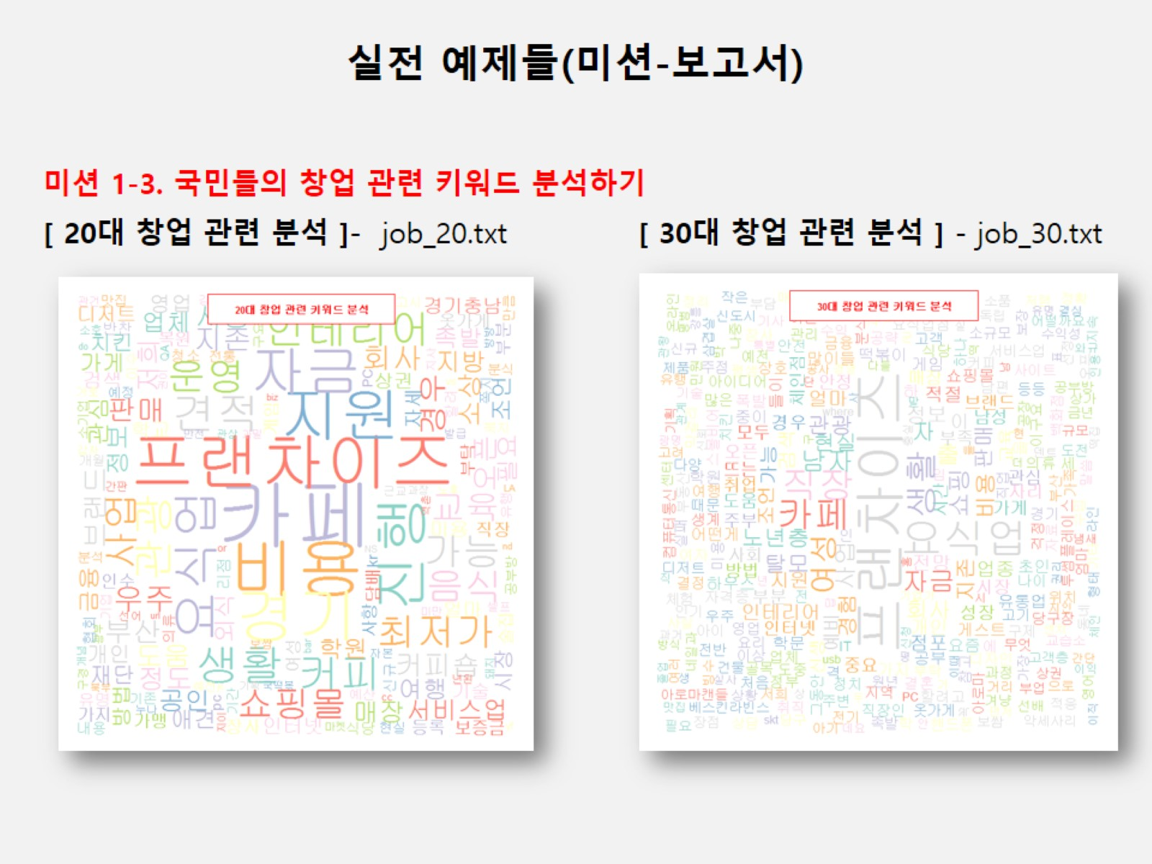

Slide 9
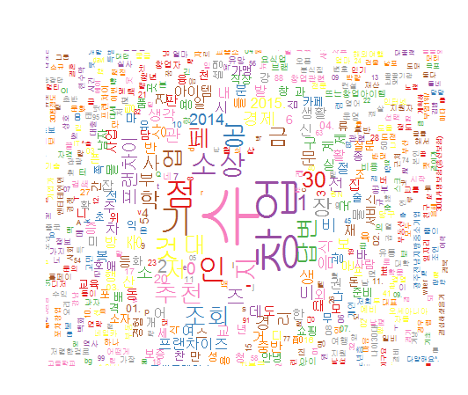
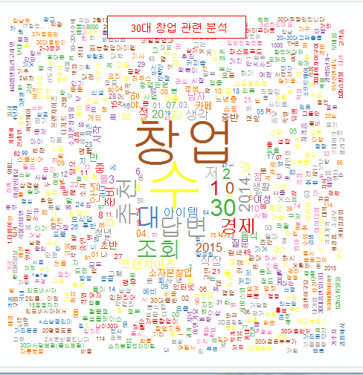
20대 vs 30대 창업 분석
Notes:
setwd("c:\\easy_r")
install.packages("KoNLP")
install.packages("wordcloud")
library(KoNLP)
library(wordcloud)
txt<-readLines("job_20.txt")
nouns<-sapply(txt,extractNoun,USE.NAMES = F)
head(unlist(nouns),30)
nouns<-Filter(function(x){nchar(x)>=2},nouns)
write(unlist(nouns),"job_20_2.txt")
rev<-read.table("job_20_2.txt")
nrow(rev)
wordcount<-table(rev)
head(sort(wordcount,decreasing = T),30)
library(RColorBrewer)
palete<-brewer.pal(9,"Set1")
wordcloud(names(wordcount),freq=wordcount,scale=c(5,0.5),rot.per = 0.25,min.freq=1,random.order = F,random.color=T,colors=palete)
legend(0.3,1, "20대 창업 관련 분석",cex=0.8,fill=NA,border=NA,bg="white",text.col="red",text.font=2,box.col="red")
setwd("c:\\easy_r")
install.packages("KoNLP")
install.packages("wordcloud")
library(KoNLP)
library(wordcloud)
txt<-readLines("job_30.txt")
nouns<-sapply(txt,extractNoun,USE.NAMES = F)
head(unlist(nouns),30)
nouns<-Filter(function(x){nchar(x)>=2},nouns)
write(unlist(nouns),"job_30_2.txt")
rev<-read.table("job_30_2.txt")
nrow(rev)
wordcount<-table(rev)
head(sort(wordcount,decreasing = T),30)
library(RColorBrewer)
palete<-brewer.pal(9,"Set1")
wordcloud(names(wordcount),freq=wordcount,scale=c(5,0.5),rot.per = 0.25,min.freq=1,random.order = F,random.color=T,colors=palete)
legend(0.3,1, "30대 창업 관련 분석",cex=0.8,fill=NA,border=NA,bg="white",text.col="red",text.font=5,box.col="red")

Slide 10
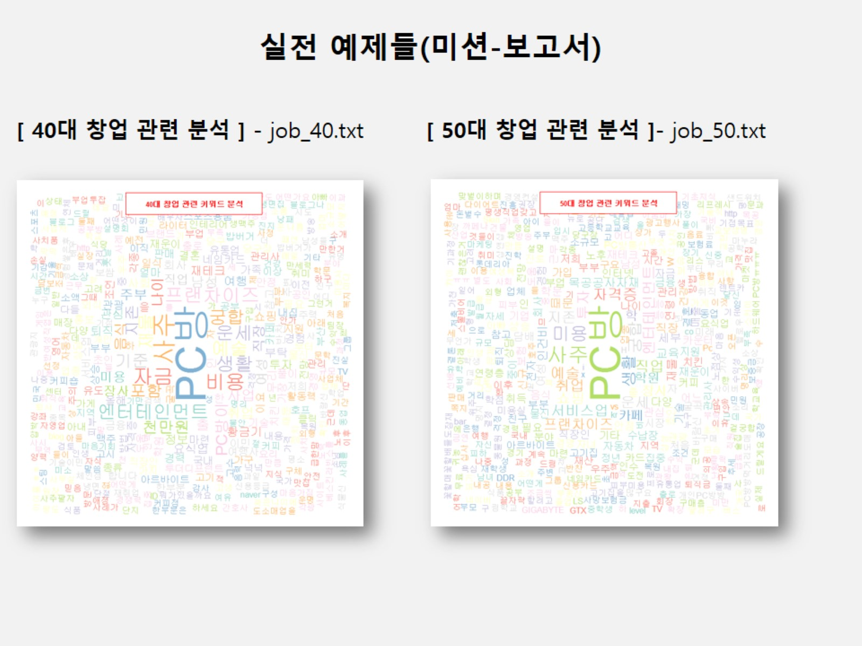

Slide 11
조별 과제
조별 프로젝트 주제어를 네이버로 크롤링 한 후 wordcloud 만들기

Slide 12
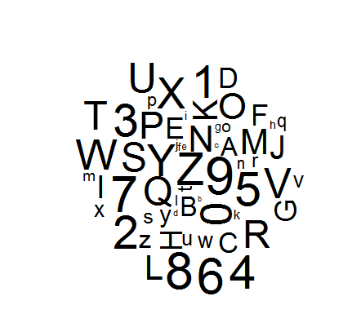
대문자 소문자 0~9
install.packages("wordcloud")
library(wordcloud)
wordcloud(c(letters,LETTERS,0:9),seq(1,1000,len=62))
Notes:
install.packages("wordcloud")
library(wordcloud)
wordcloud(c(letters,LETTERS,0:9),seq(1,1000,len=62))

Slide 13
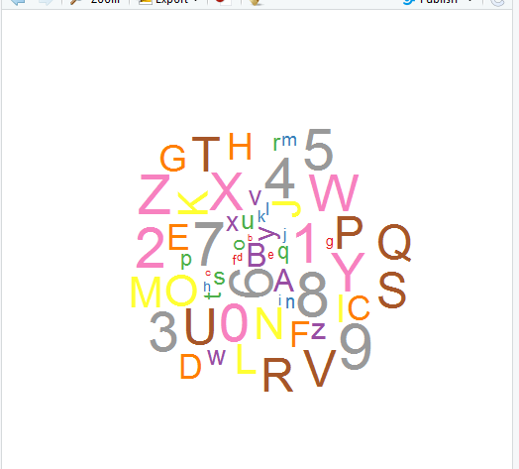
대문자 소문자 0~9 palete
Library(RColorBrewer)
palete
Notes:
library(wordcloud)
wordcloud(c(letters,LETTERS,0:9),seq(1,1000,len=62))
library(RColorBrewer)
palete<-brewer.pal(9,"Set1")
wordcloud(c(letters,LETTERS,0:9),seq(1,1000,len=62),colors=palete)

